Slide 1

Performance of TimeForce App
Young C.

Slide 2
Definitions
ESFU vs. NSFU
I will be using 2 abbreviations, ESFU and NSFU, each representing a mutually exclusive type/group of TimeForce Users
ESFU (Existing SalesForce User): TimeForce Users that DID have history of using other SalesForce products before they first tried TimeForce
NSFU (New SalesForce User): TimeForce Users that DID NOT have history of using other SalesForce products before they first tried TimeForce
Note: This field(user attribute) does NOT update!
This means even after NSFU onboards to other SalesForce products, this user will NOT change to ESFU

Slide 3
How is TimeForce doing?
Monthly Active Users (MAU)
New User Acquisition
Retention % by Cohort
Usage Segmentation by Cohort

Slide 4
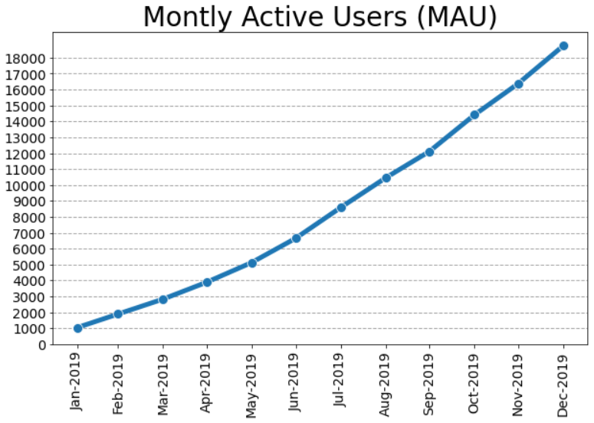
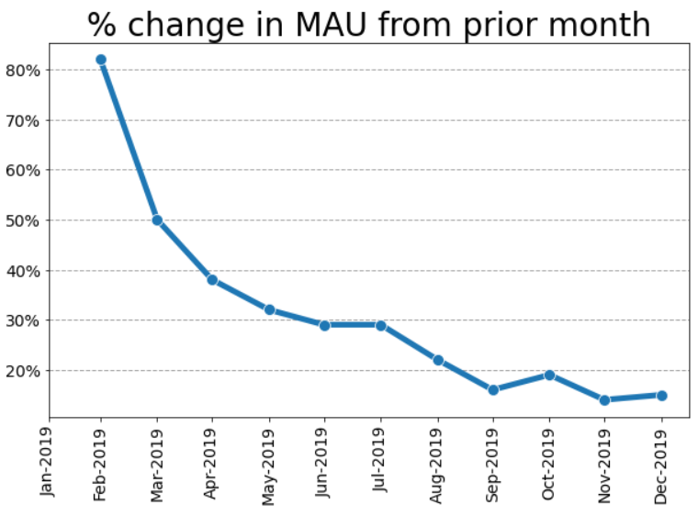
Monthly Active Users (MAU)

Slide 5
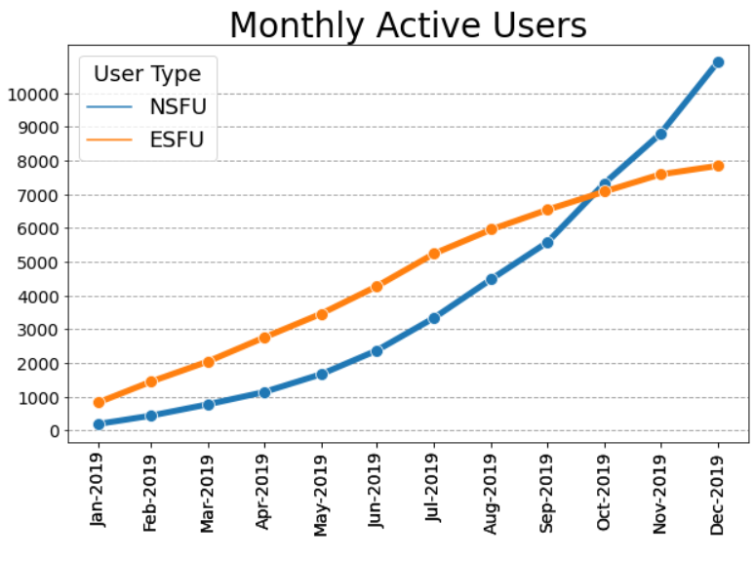
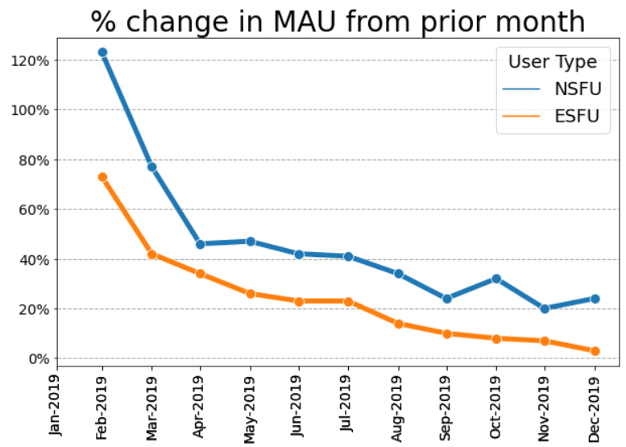
Monthly Active Users (MAU) by User Type

Slide 6
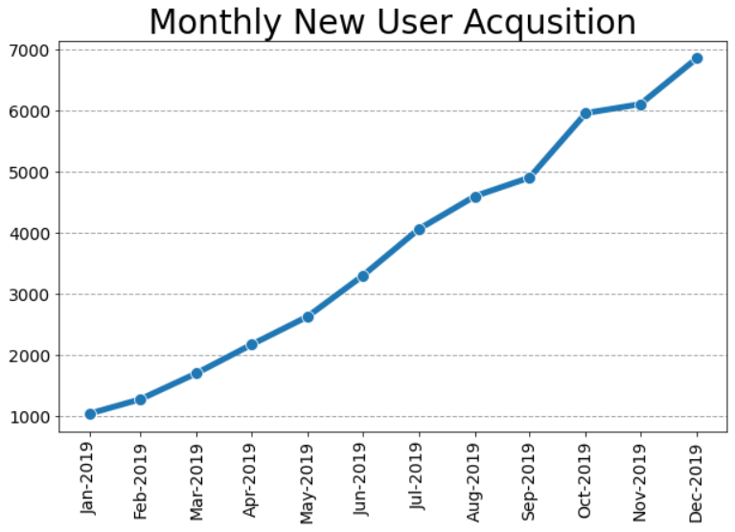
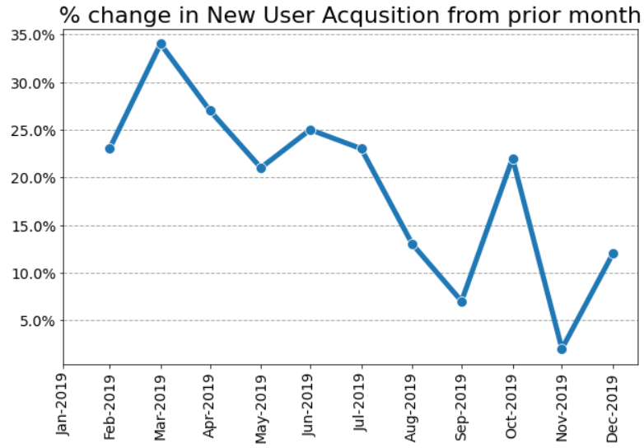
New User Acquisition

Slide 7
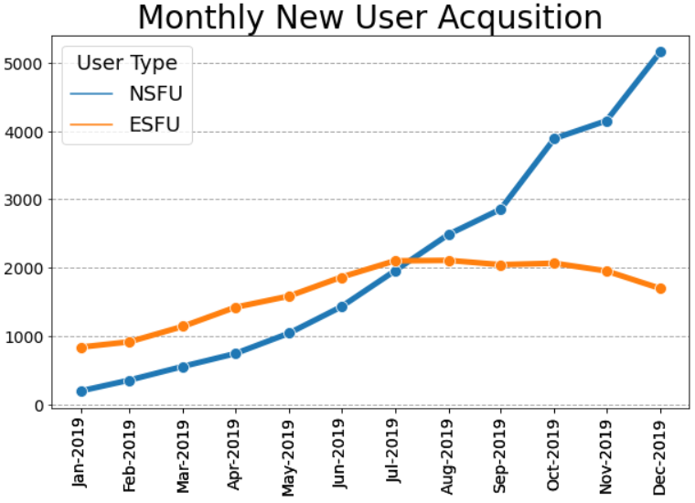
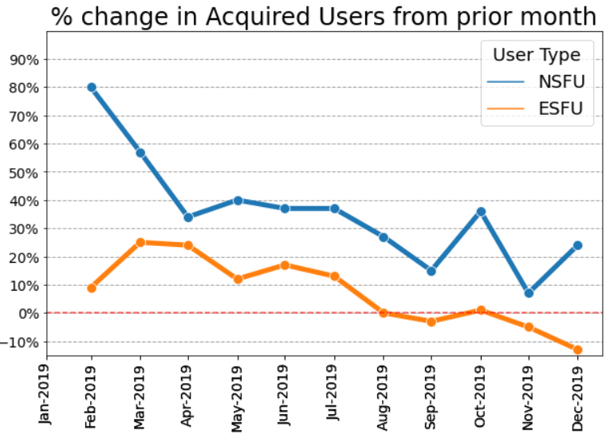
New User Acquisition by User Type
3 month rolling avg of growth in NSFU acquisition: +22%
3 month rolling avg of growth in ESFU acquisition: -6%

Slide 8
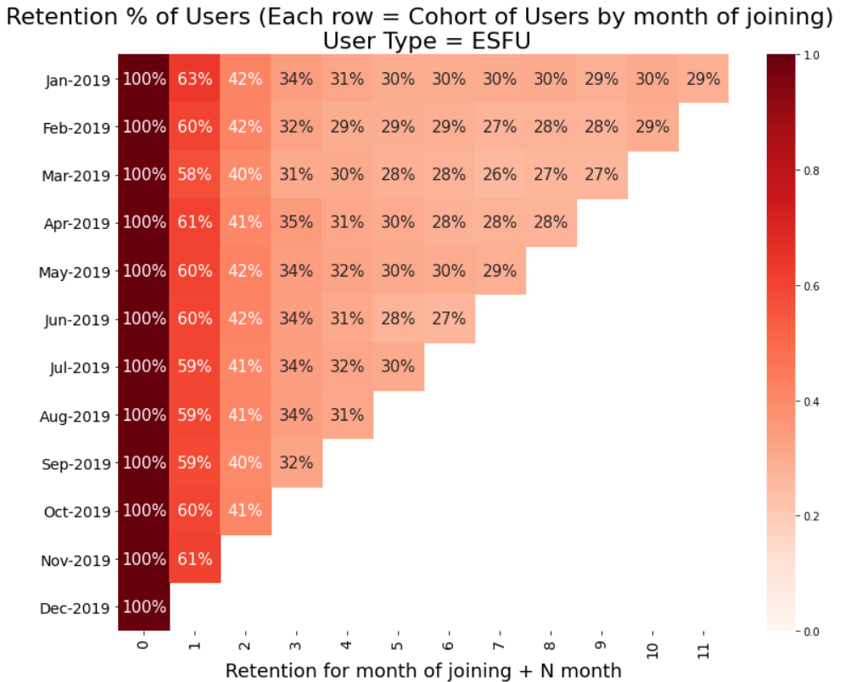
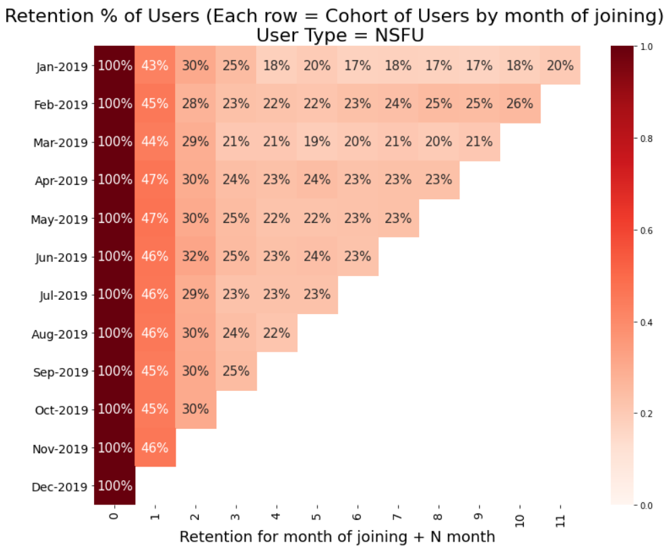
Retention % by Cohort
User Type: ESFU
User Type: NSFU

Slide 9
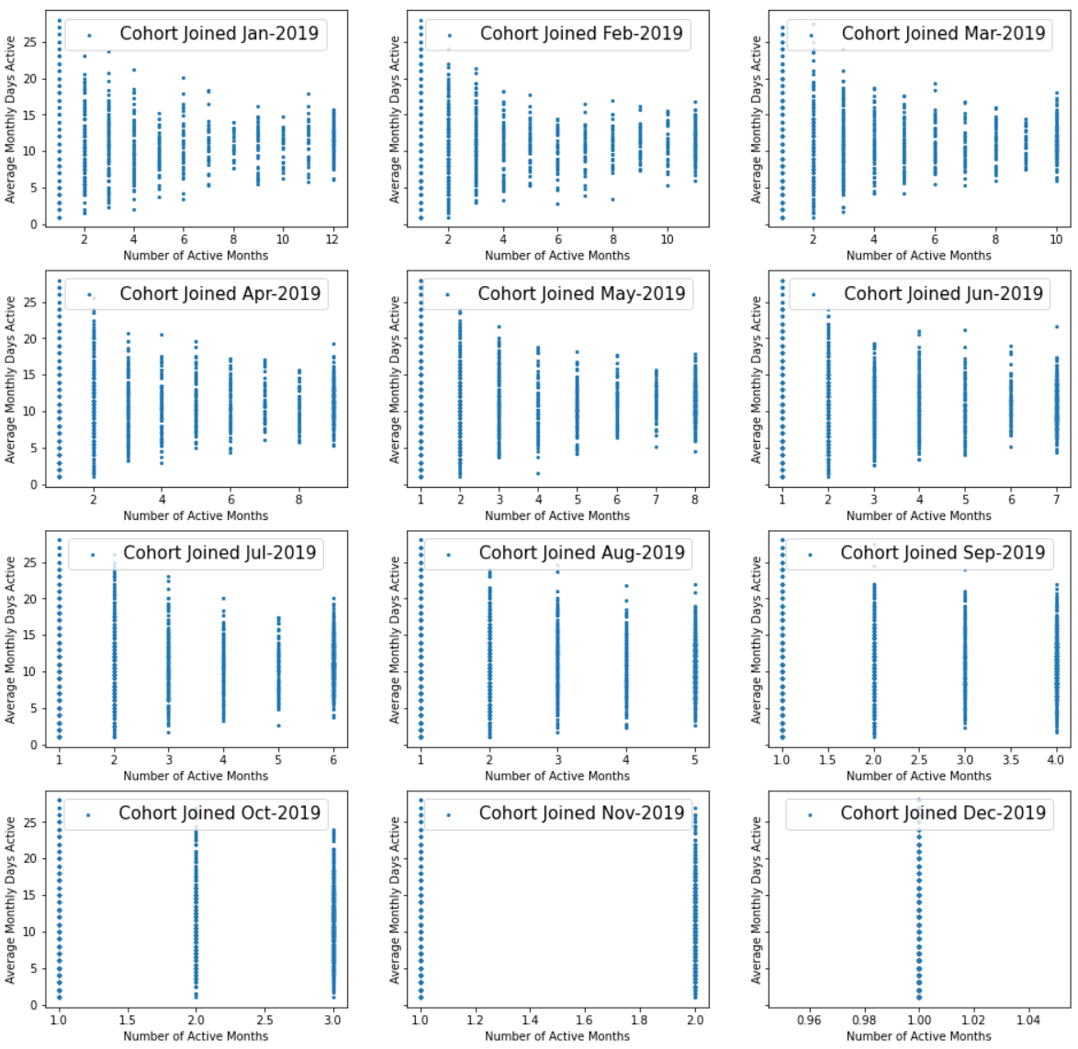
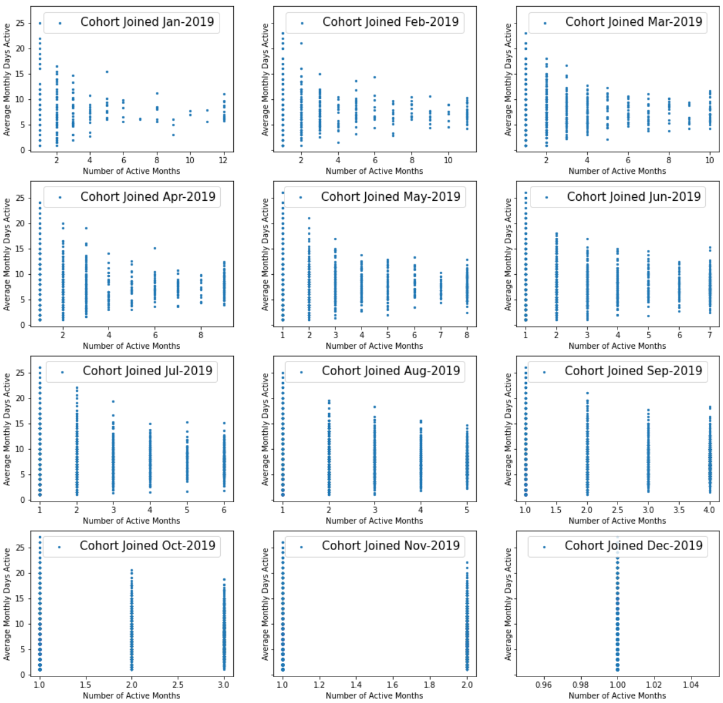
Usage Segmentation by Cohort
Number of Active Months vs. Average Monthly Days Active (at each customer-level)
User Type: ESFU
User Type: NSFU

Slide 10
What should we focus on to grow TimeForce adoption?
Option 1: Focus on Acquisition of NSFU over ESFU
Option 2: Improve NSFU’s Low Retention % Issue

Slide 11
What should we focus on to grow TimeForce adoption?
Option 1: Focus on Acquisition of NSFU over ESFU
Even though NSFU only represented 20% of MAU in the 1st month of product launch (Jan. ‘19), because of its stronger rate of growth relative to ESFU, NSFU has become the majority of users by Oct. ‘19, and by Dec. ‘19 NSFU represented 58% of overall MAU.
Growth of ESFU has plateaued (3 month rolling average of growth in new user acquisition of -6% per month, compared to NSFU still strong at +22% per month).

Slide 12
What should we focus on to grow TimeForce adoption?
Option 2: Improve NSFU’s Low Retention % Issue
Compared to ESFU, NSFU exhibits lower retention rate (10%~15% lower) across cohort of users that joined in the same month. Considering the fact that a bulk of future MAU growth will most likely come from NSFU, fixing this will likely to have a major positive impact on the product adoption, but in order to fix it we first need to understand why NSFU suffer from the retention issue.
One major pattern noticeable from usage segmentation (Number of active months vs. Avg monthly days active) is that the distributions of average monthly days active are actually shaped similar for NSFU and ESFU that used TimeForce for less than 1 month. However as we move along (increase) the number of active months bucket, the variations in the distribution of average monthly days active (between users) decrease significantly for both NSFU and ESFU, while average reduction in variation was much higher for NSFU). Also, the distributions of avg monthly days active for ESFU are skewed more to the right compared to NSFU. In other words, ESFU with consistent usage have considerably higher usage frequency than NSFU with consistent usage.
Hypothesis: There are many NSFU that try TimeForce with the intentions of using it for professional purpose (“pro-NSFU”), but because they are not as familiar or have existing knowledge of other SalesForce products, they experience steeper learning hurdles than pro-ESFU, thus pro-NSFU 1-month-churn at a higher rate than pro-ESFU.
Recommendations:
Build or improve in-app tutorials of how to use TimeForce (especially to support professional use cases) or file a support ticket.
If we have to make a decision to invest in either feature X or feature Y, then gravitate towards the feature that aligns more with professional use than for personal use.

Slide 13
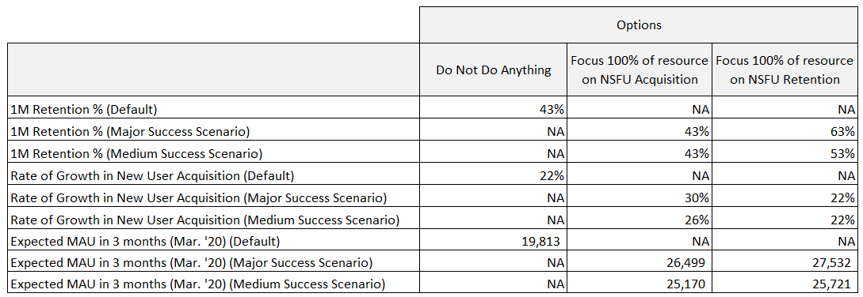
Focus on Acquisition? OR Improve Retention?
Expected MAU in 3 months has been calculated using:
Previous month’s MAU + acquisition from current month * (base rate * 1+Expected Improvement in acquisition) - acquisition from previous month * (base rate * (1+ Expected Improvement in retention)
Base rates (43% for retention rate & 22% for acquisition growth rate) used are 3 months rolling average for each user group

Slide 14
Where should we look further?
Compute absorption rates for NSFU to other SalesForce products and factor this into CLTV calculation to optimize multi-channel marketing campaigns.
Estimate the impact of using TimeForce (for ESFU) on usage of other SalesForce product they were already using.
Estimate the impact of using TimeForce (for ESFU) on signing up for other SalesForce products they never used before trying TimeForce.

